Slide 1


Nahant Marsh: 20+ Years of Good Urban Floodplain Restoration
Brian Ritter-Executive Director

Slide 2
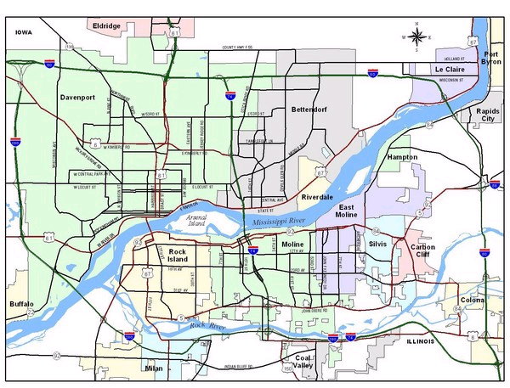
Nahant
Marsh
Milan Bottoms

Slide 3
Nahant’s Past
Formed by Ice, Fire, and Flood
1833-1851- Rockingham, Iowa
1882-1958- Nahant, Iowa
1969-1973- I-280
1969-1995- Scott County Sportsman’s Association
1998-2000- US EPA Superfund Site
2000-Present- Nahant Marsh Education Center and Nature Preserve

Slide 4
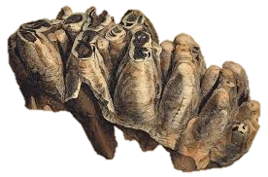



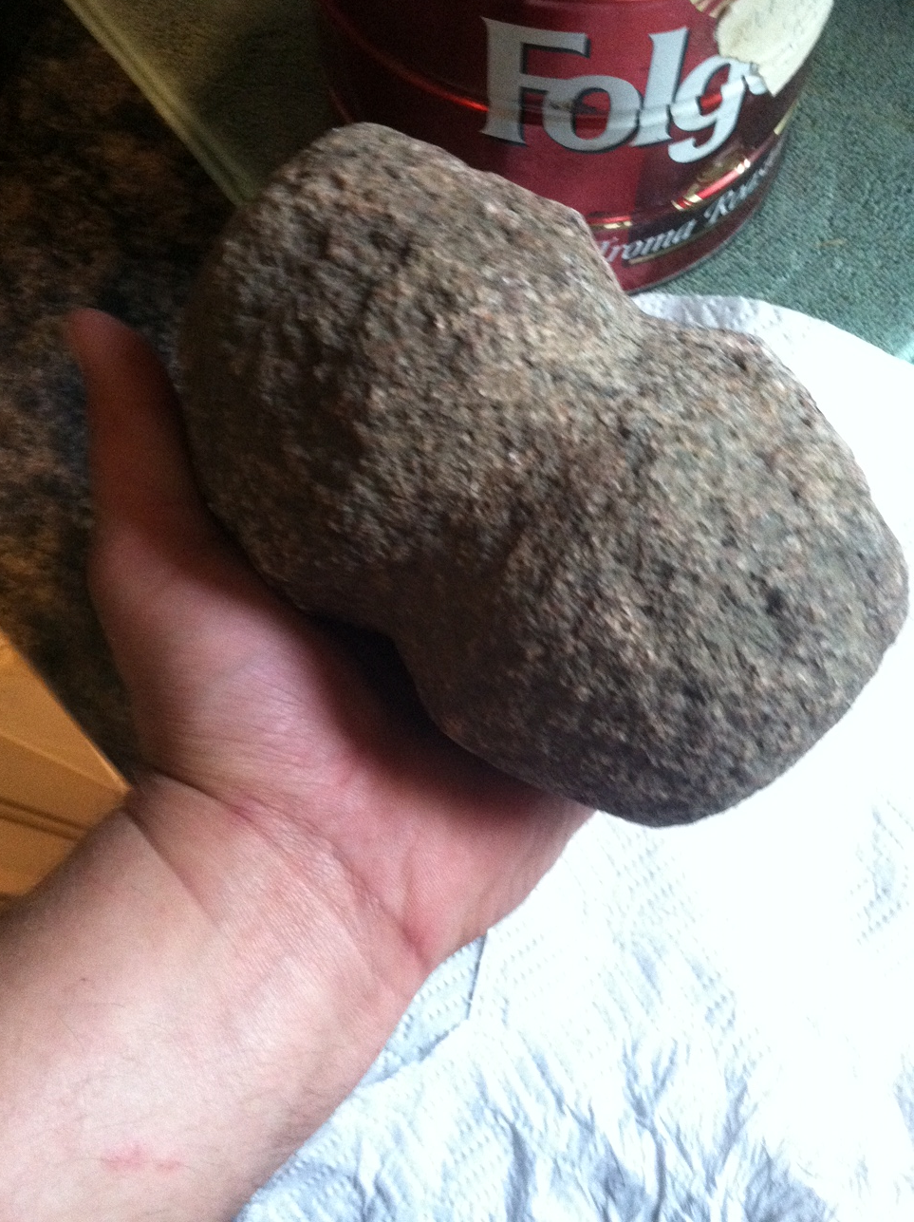
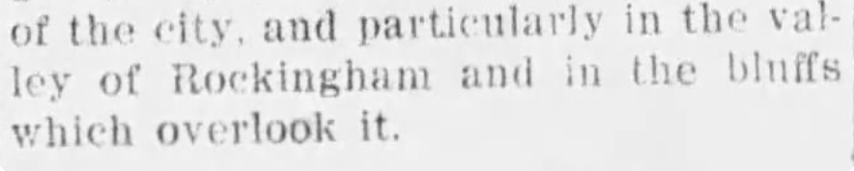
Nahant Marsh
Formed by Fire, Flood, and Ice
The Daily News, Davenport, IA, Nov. 23, 1900

Slide 5
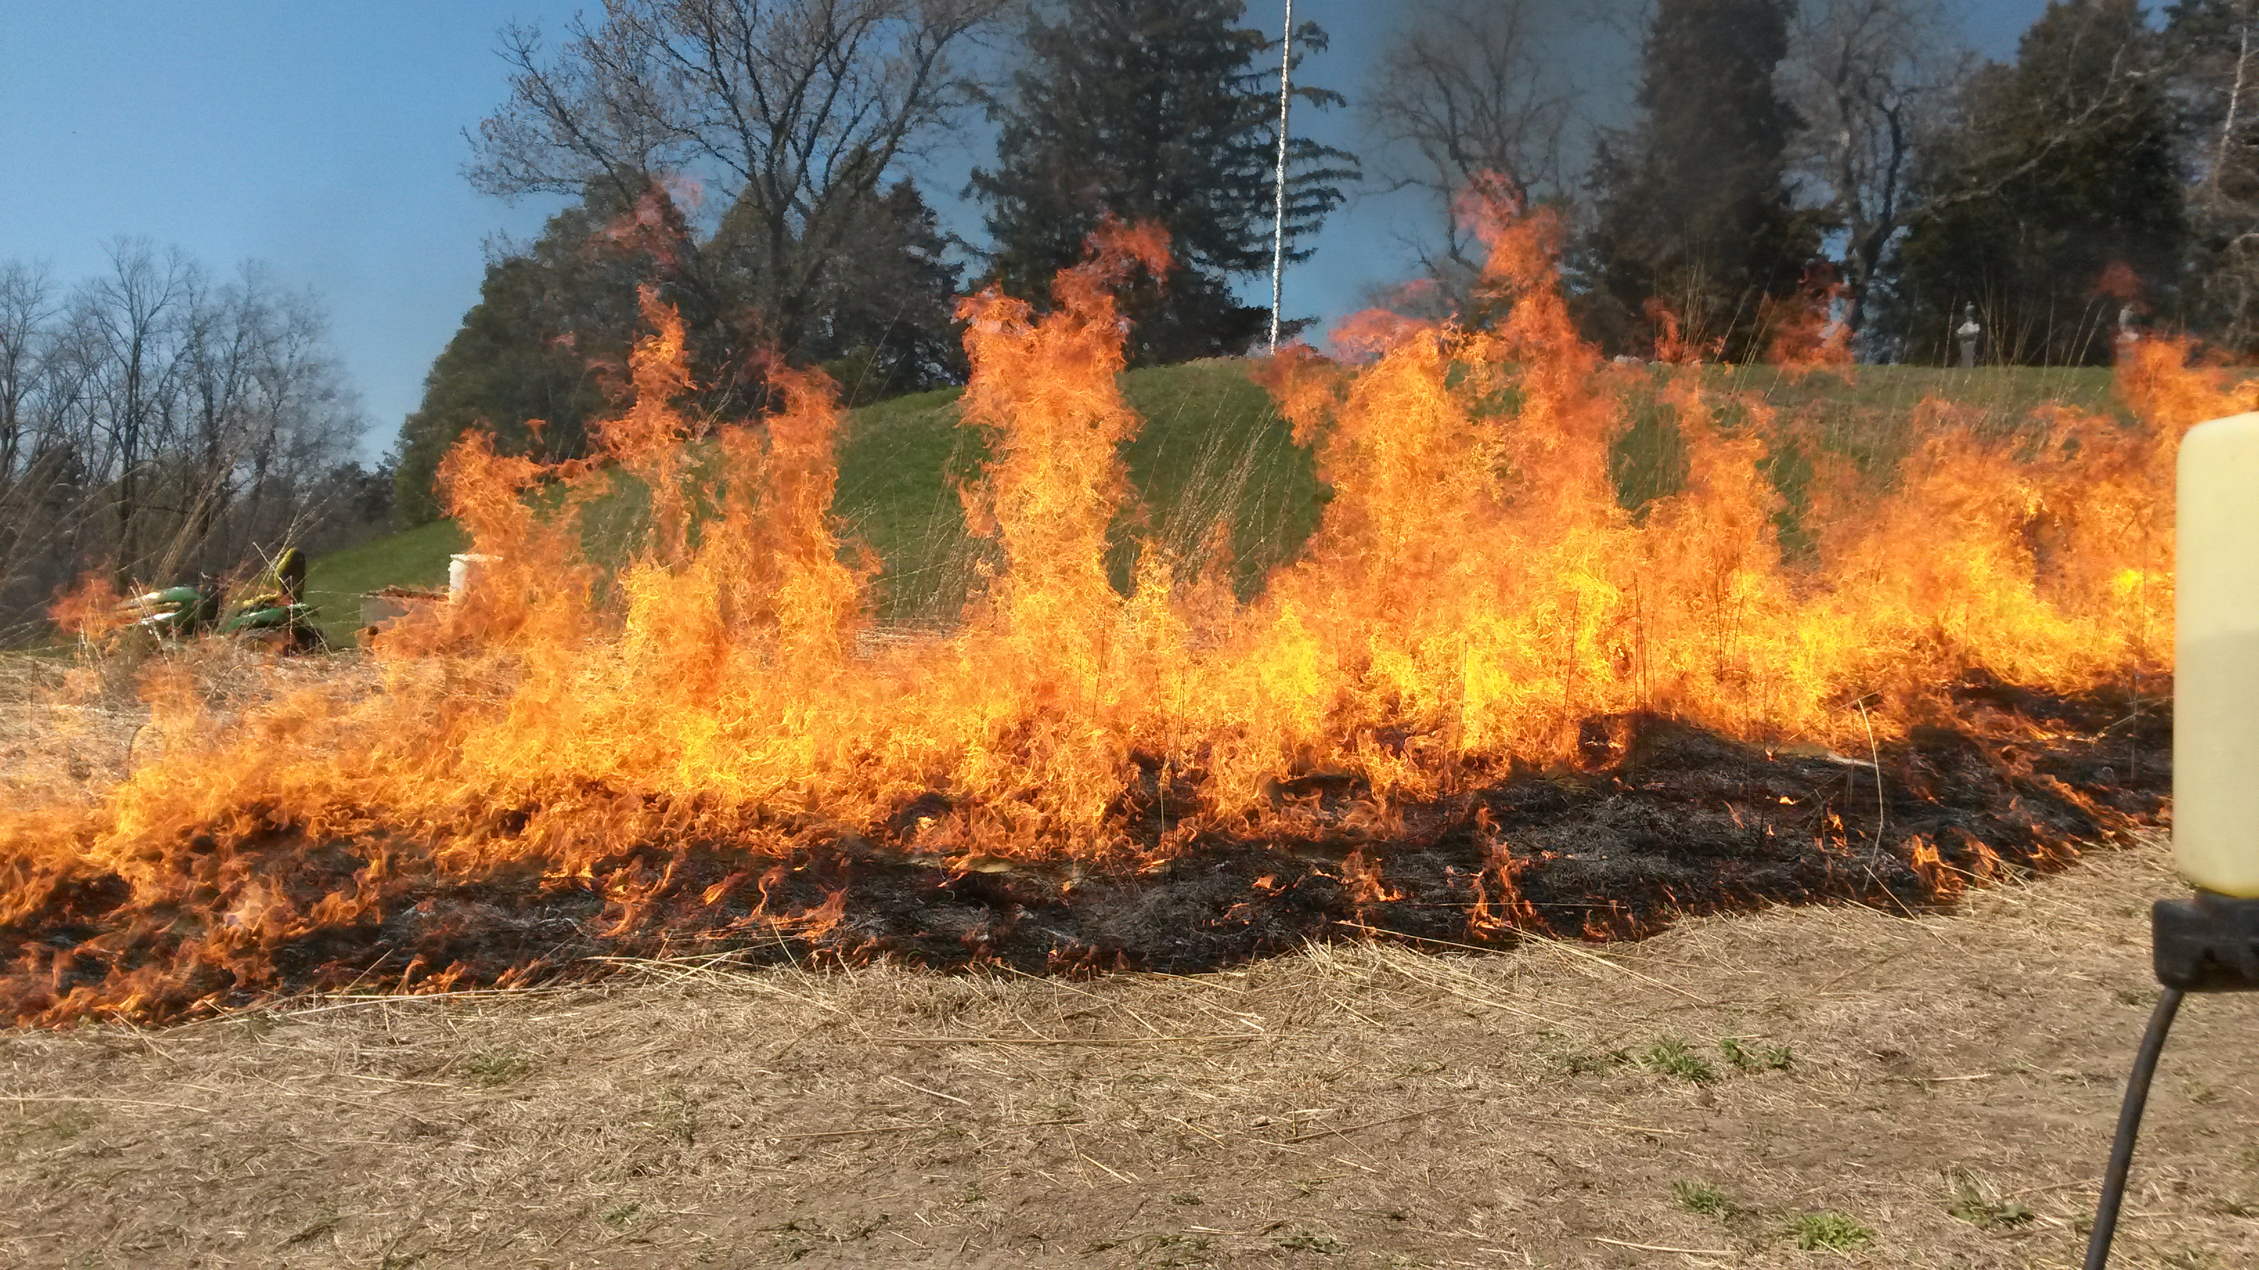
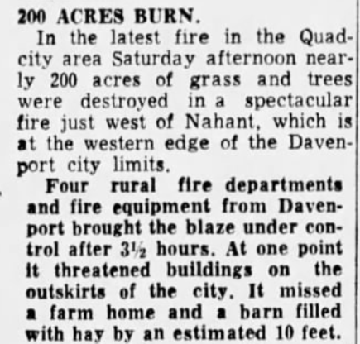
Nahant Marsh
Frequent Fires
January, 1954
October, 1952
October, 1932
November, 1933

Slide 6
Floods
Rev. John O. Foster, Rockingham Settler

Slide 7
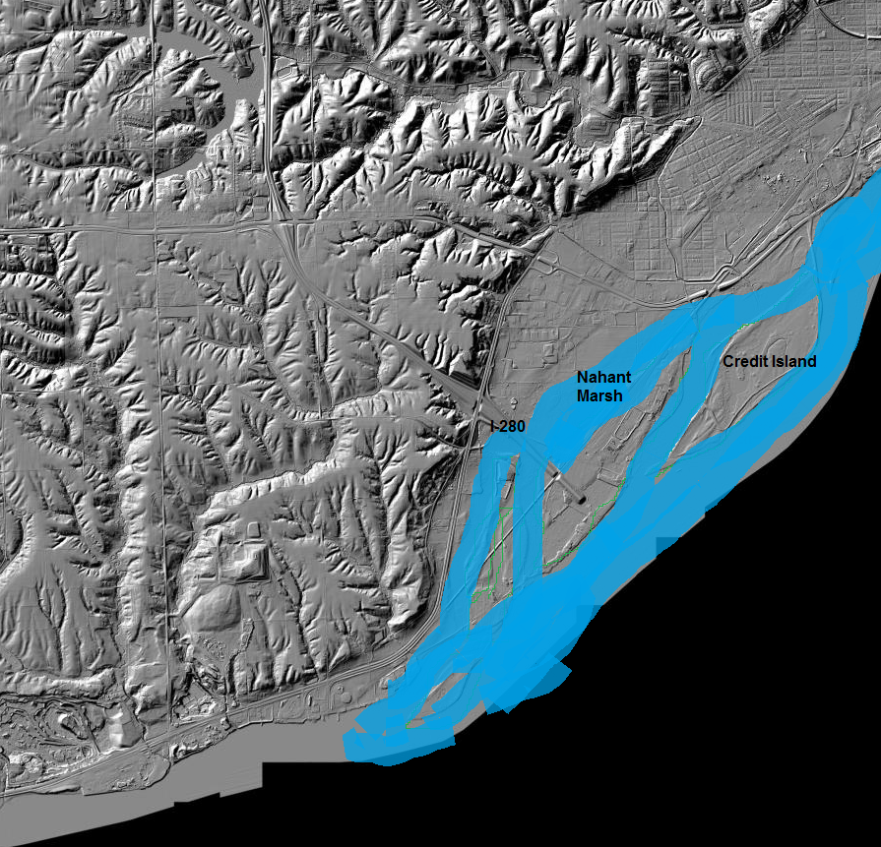

Slide 8
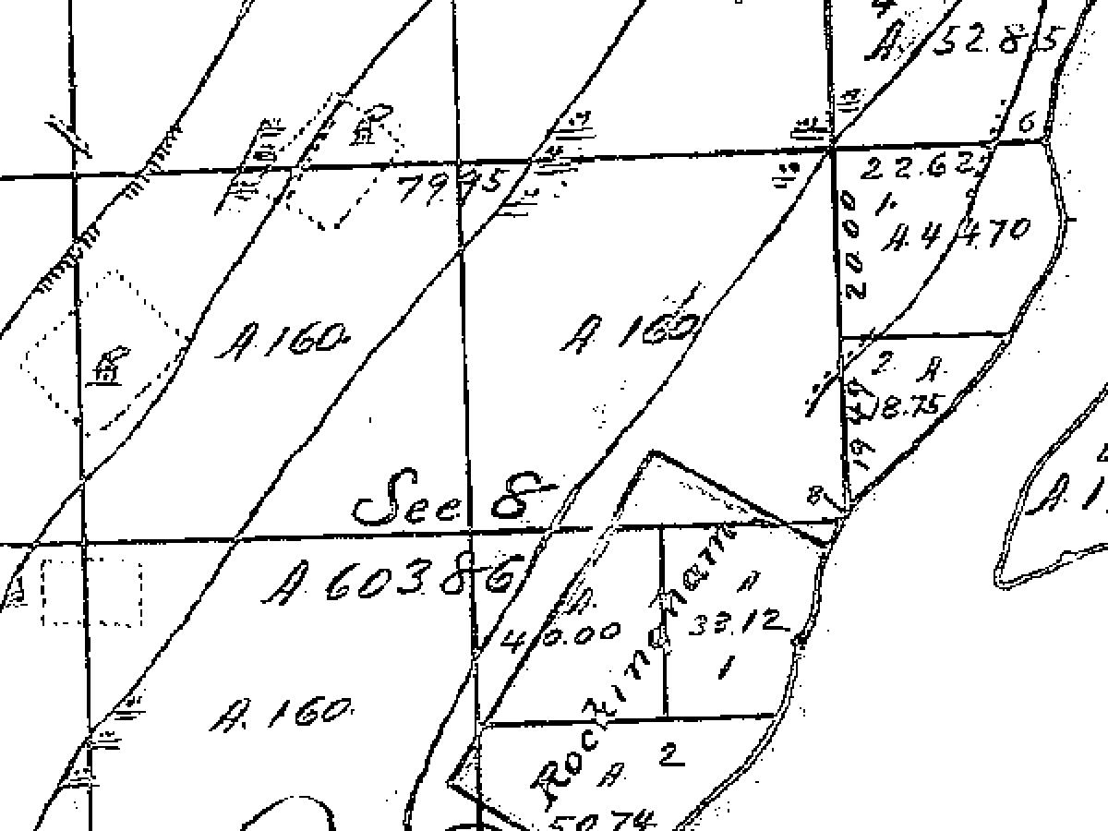
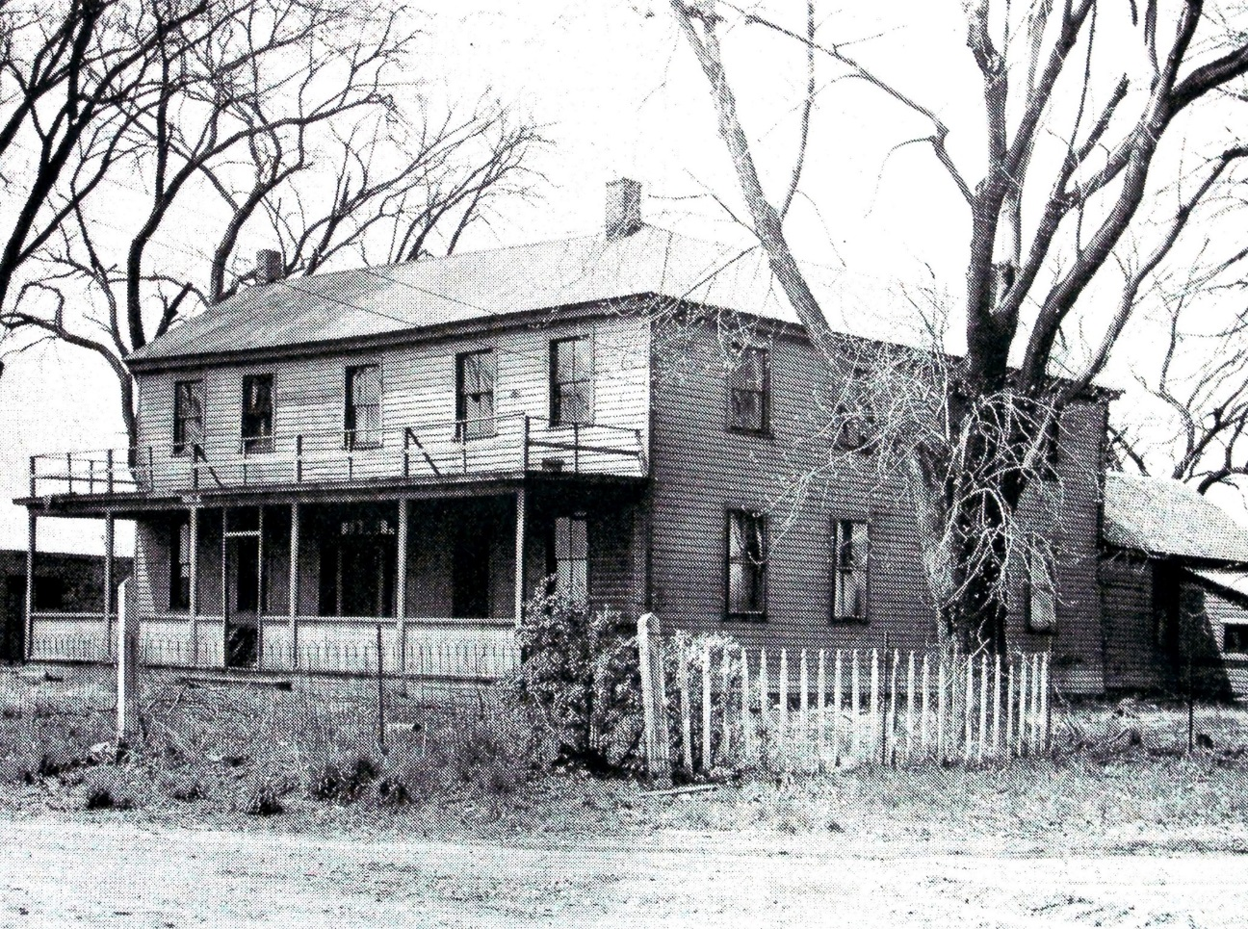
Rockingham, Iowa
1835-1851

Slide 9
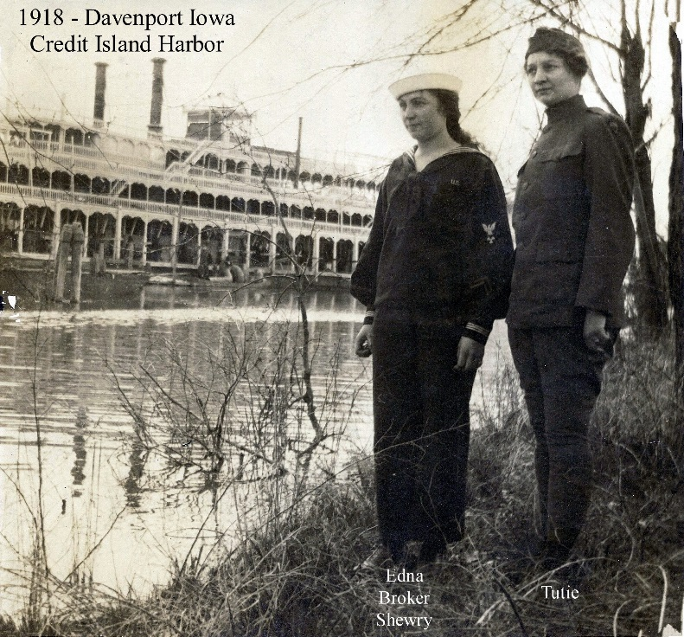
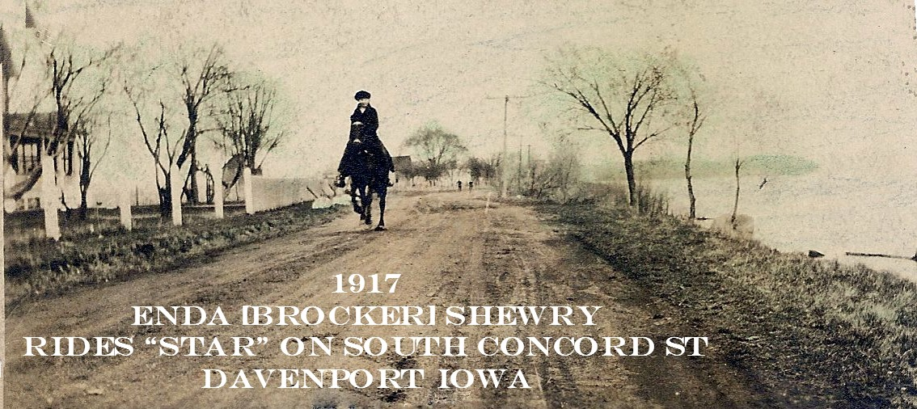
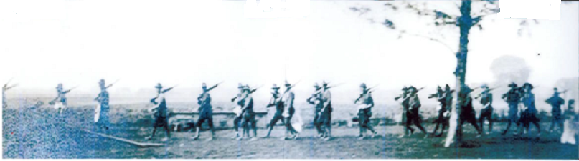
Nahant, Iowa 1882-1958
Boats, Booze, Ice, and Rails

Slide 10
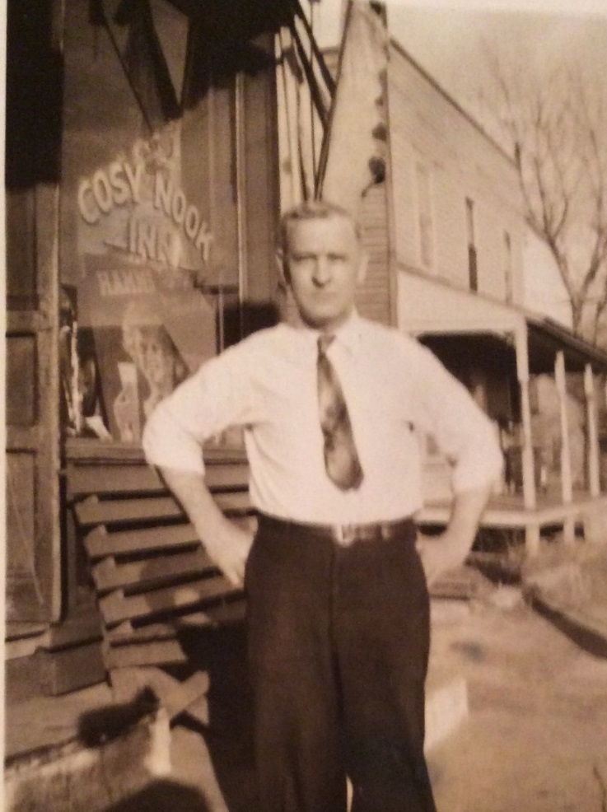
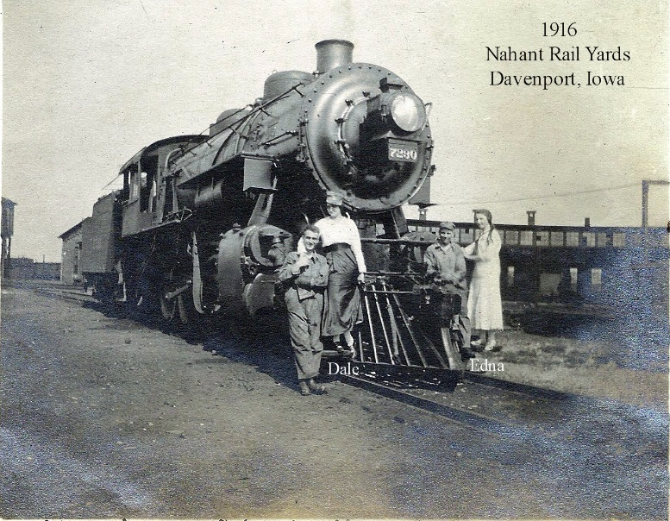
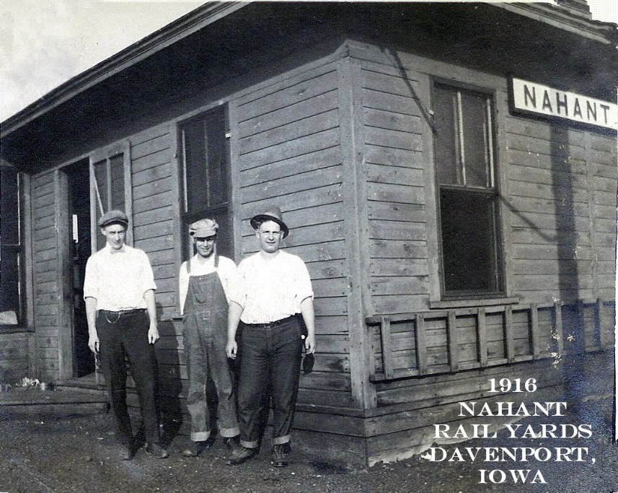
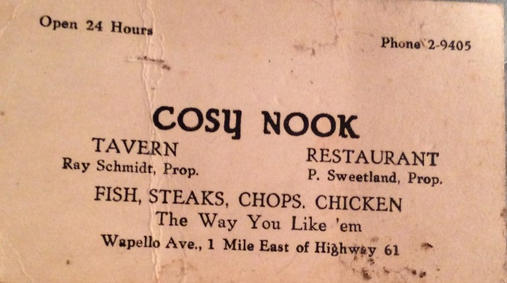
Nahant, Iowa

Slide 12
1954

Slide 13
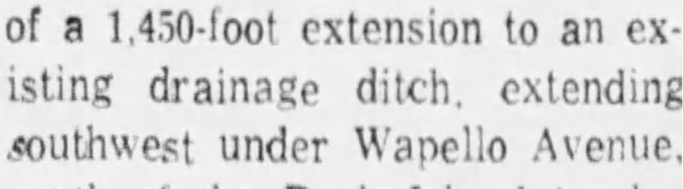
1930’s-1950’s
Drain the Swamp
July 4, 1957
October 25, 1929
September 22, 1925

Slide 14
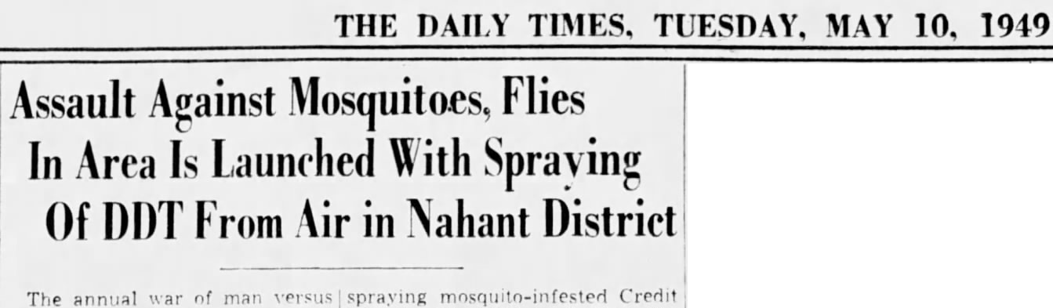
1940’s

Slide 15
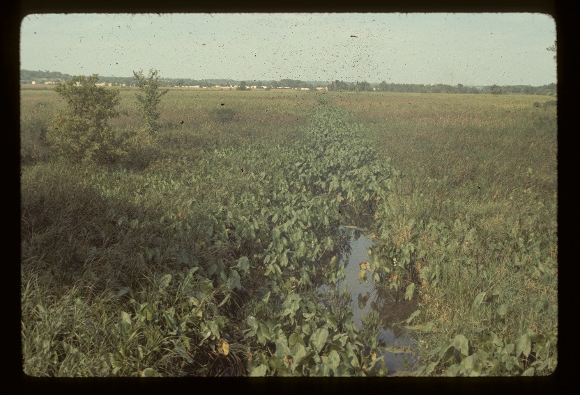
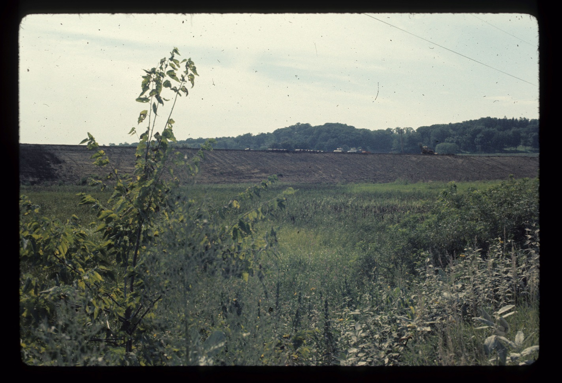
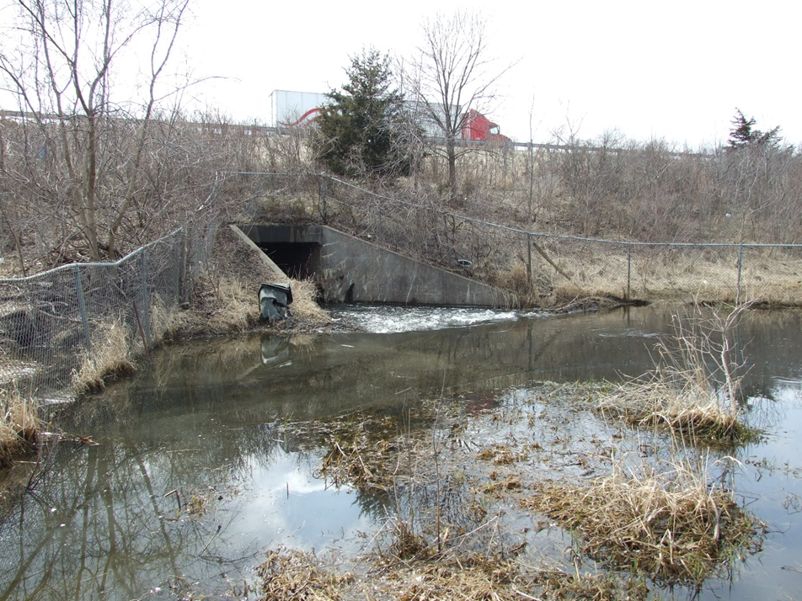
Nahant Marsh
1969-1973- Interstate 280

Slide 16

1970

Slide 17
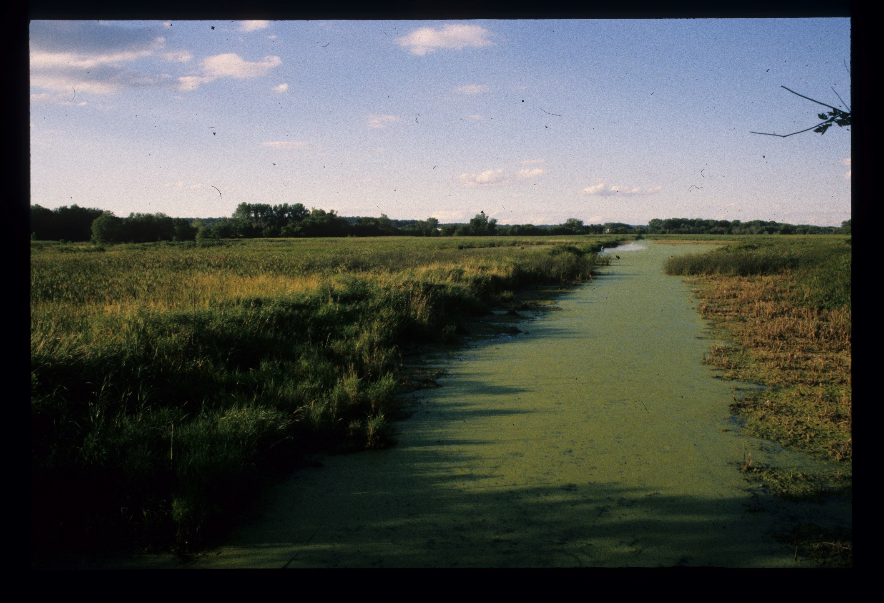
1991

Slide 18
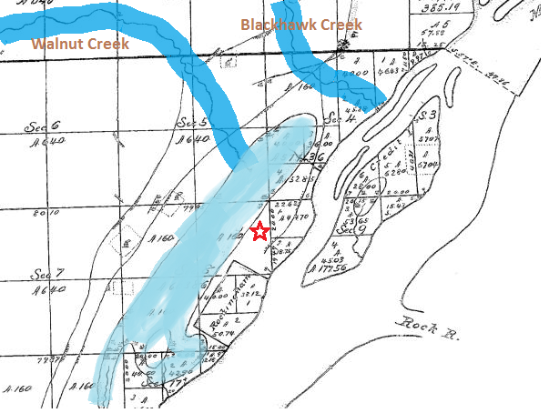
1837
Hydrology

Slide 19
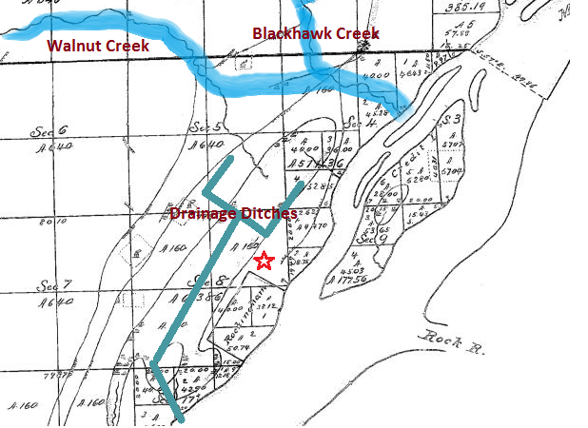
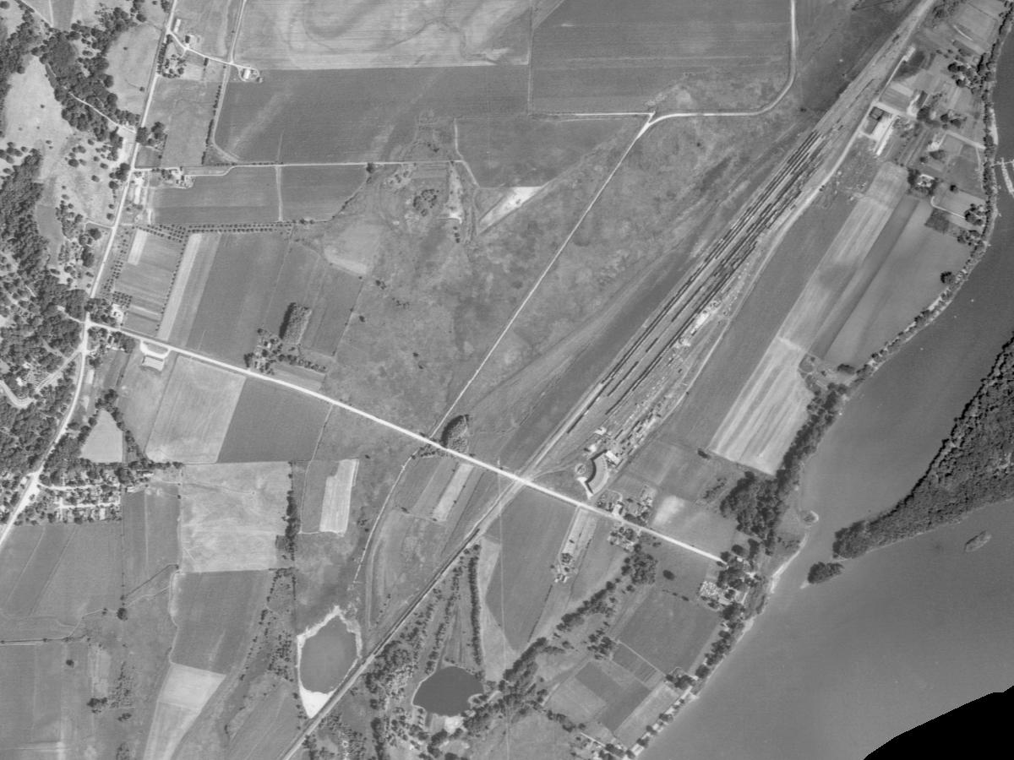
1930
Hydrology

Slide 20
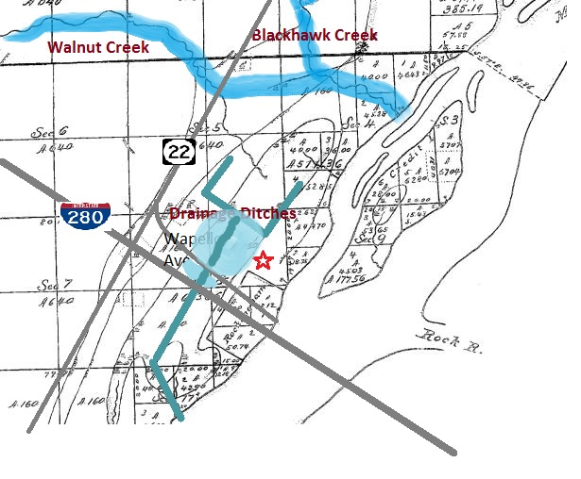
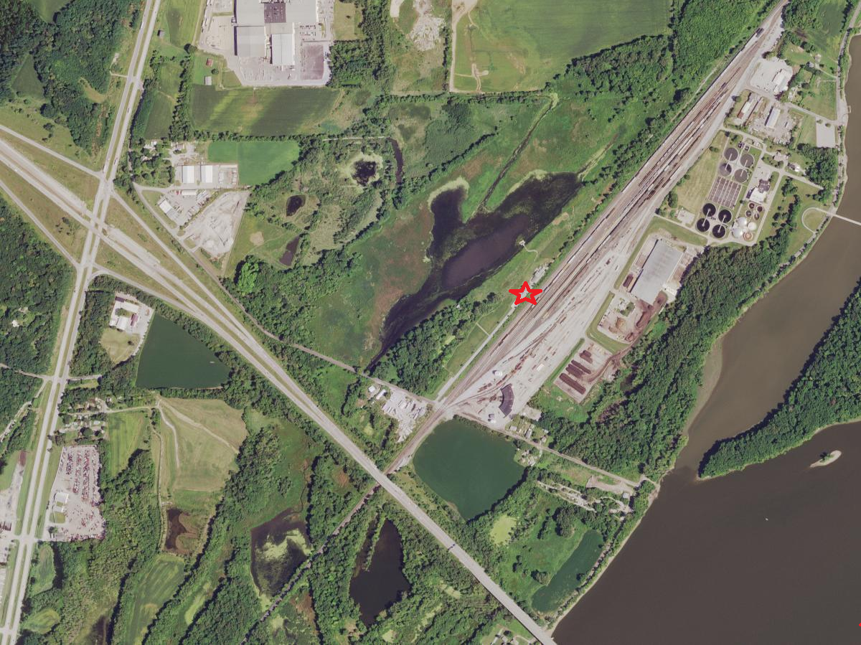
2018
Hydrology

Slide 21
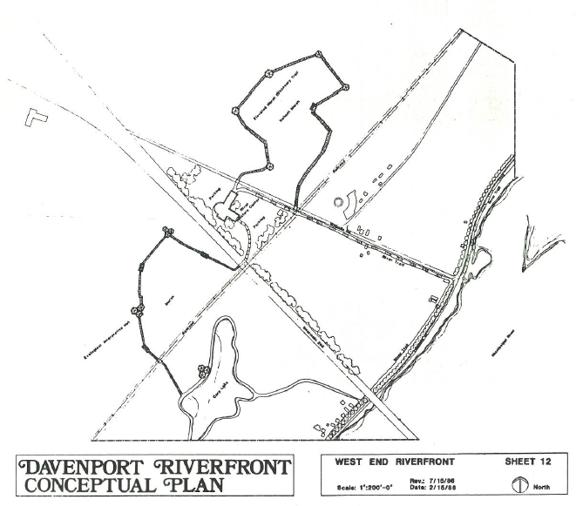
1986- Plans to save Nahant Marsh

Slide 22
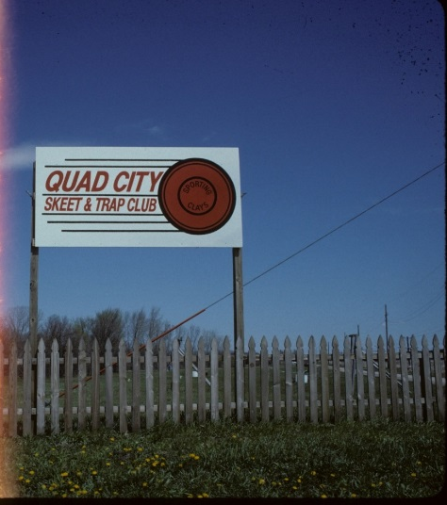
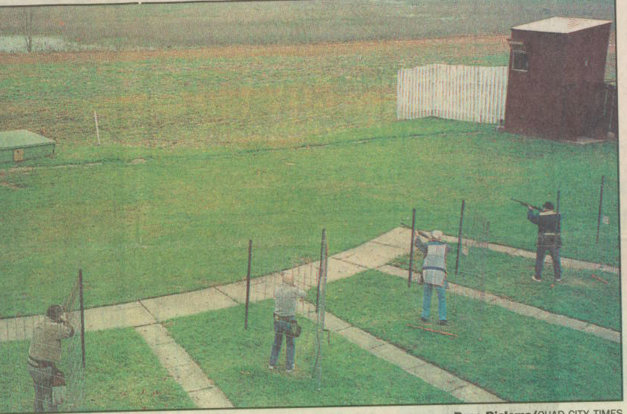
Nahant Marsh
1969-1995-Scott County Sportsmen’s Association

Slide 23
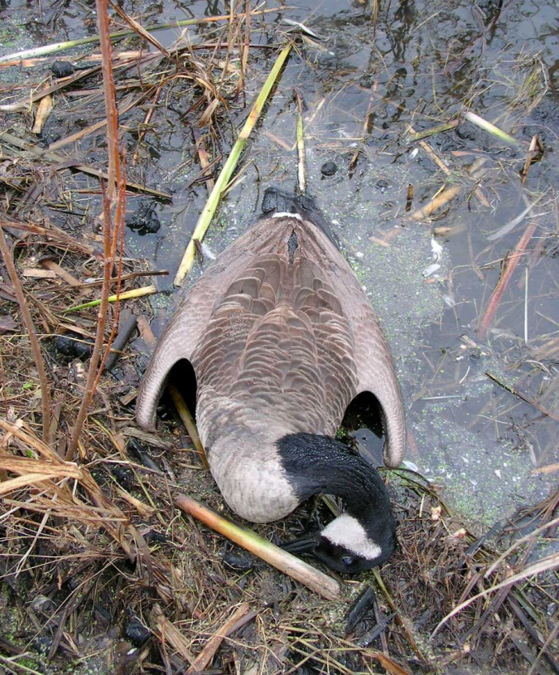
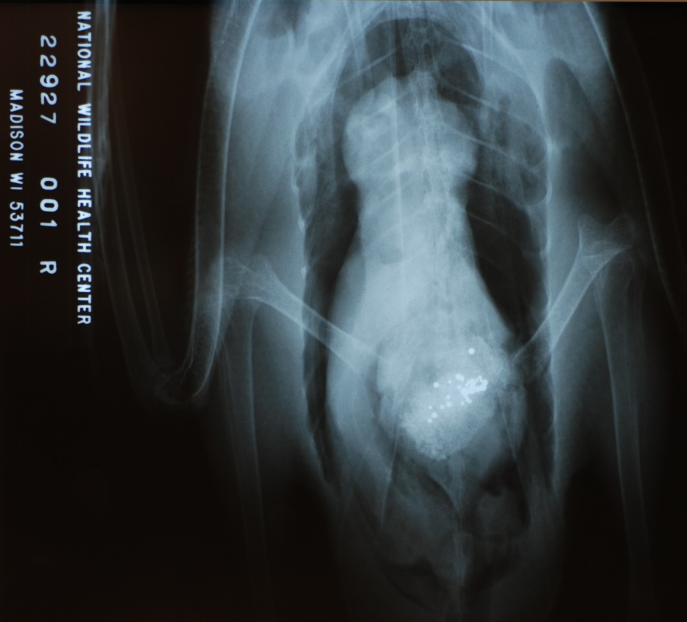
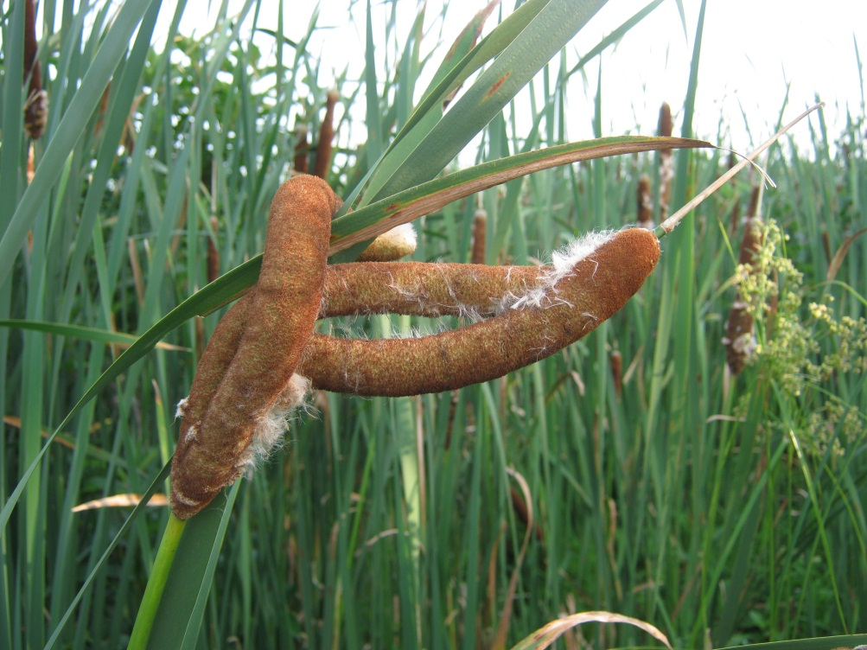
Nahant Marsh
EPA Superfund Site 1998-2000

Slide 24
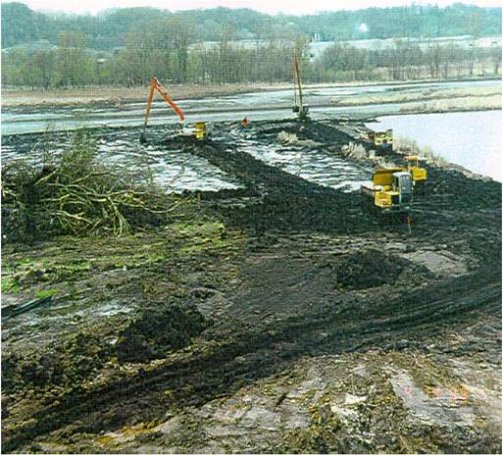

Slide 27
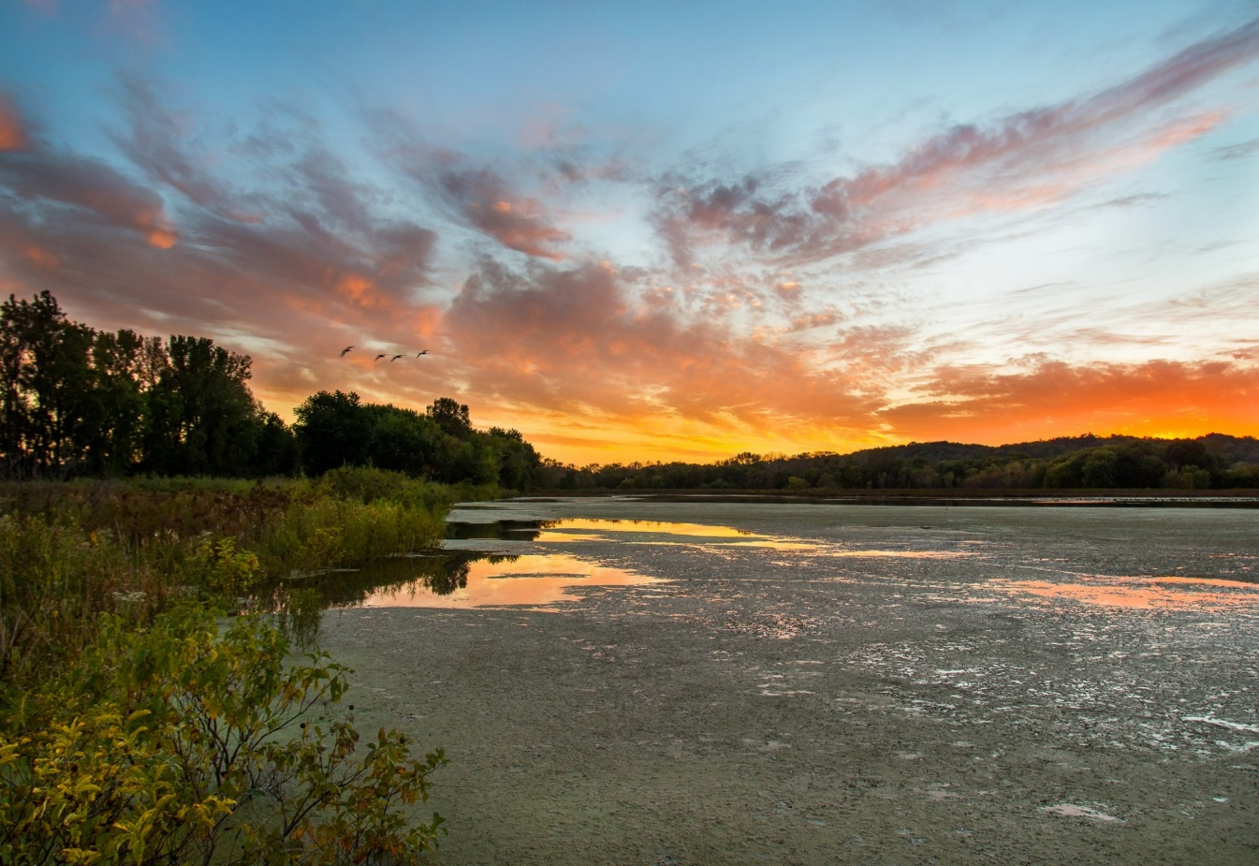
2000- Nahant Marsh Education Center Founded
A New Dawn for Nahant Marsh

Slide 30
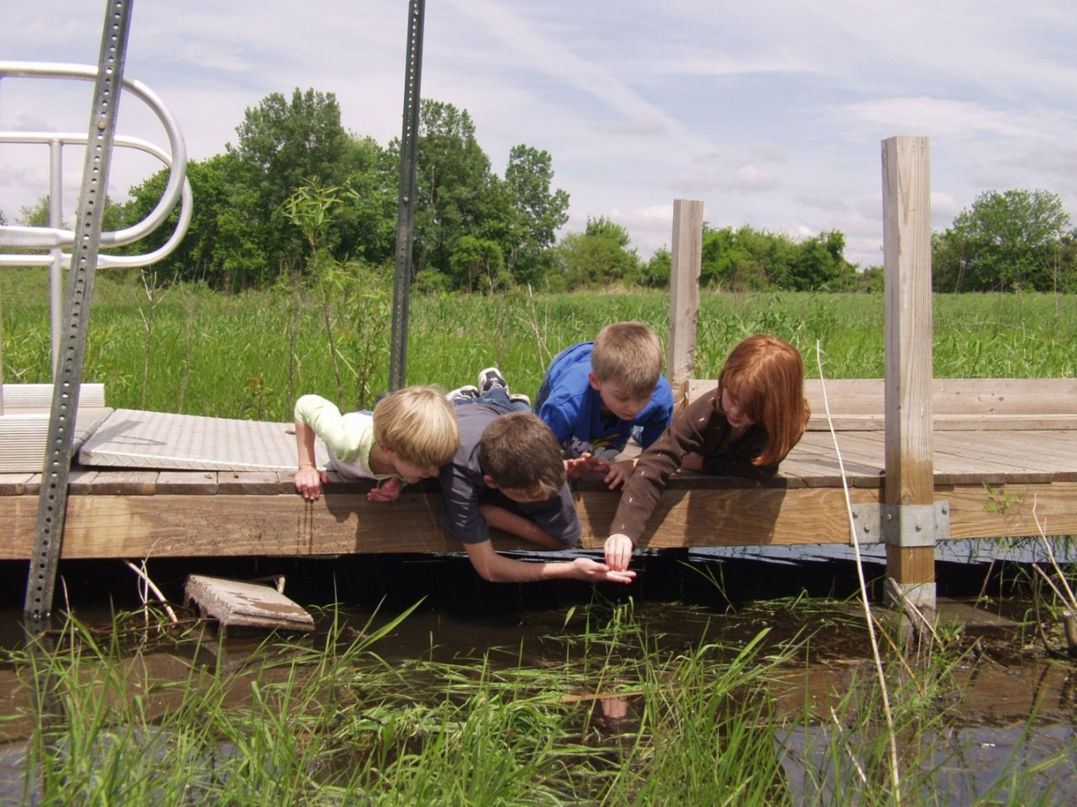
Mission: The mission of Nahant Marsh Education Center is to protect, enhance, and restore the Marsh through education, research, and conservation.
Vision: Our vision is to foster wonder, appreciation, and stewardship of the natural world.

Slide 31
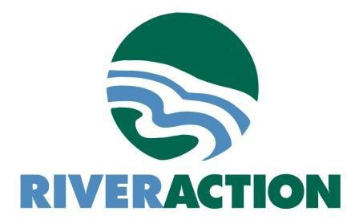






What IS Nahant?... A Partnership

Slide 32
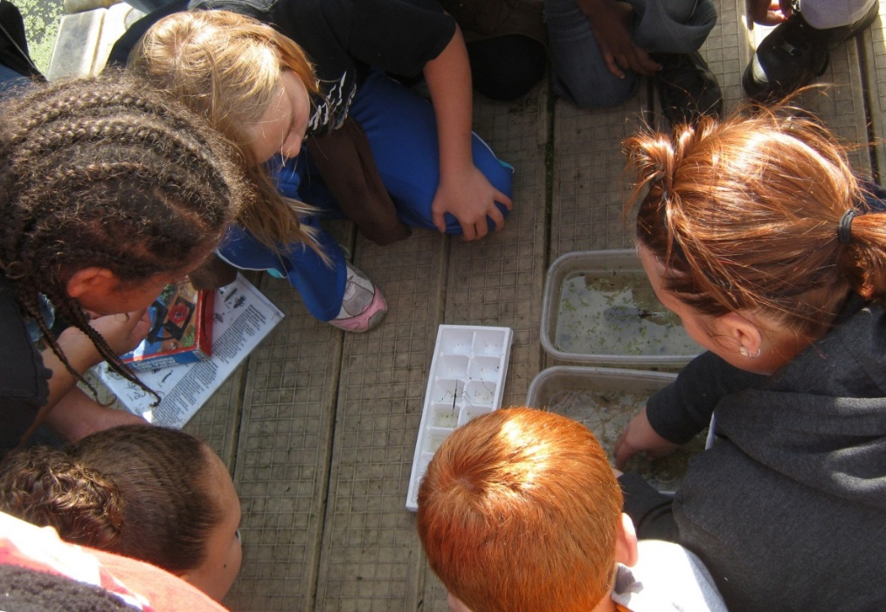
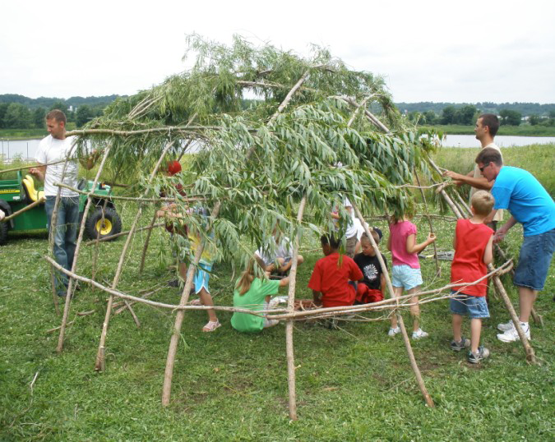
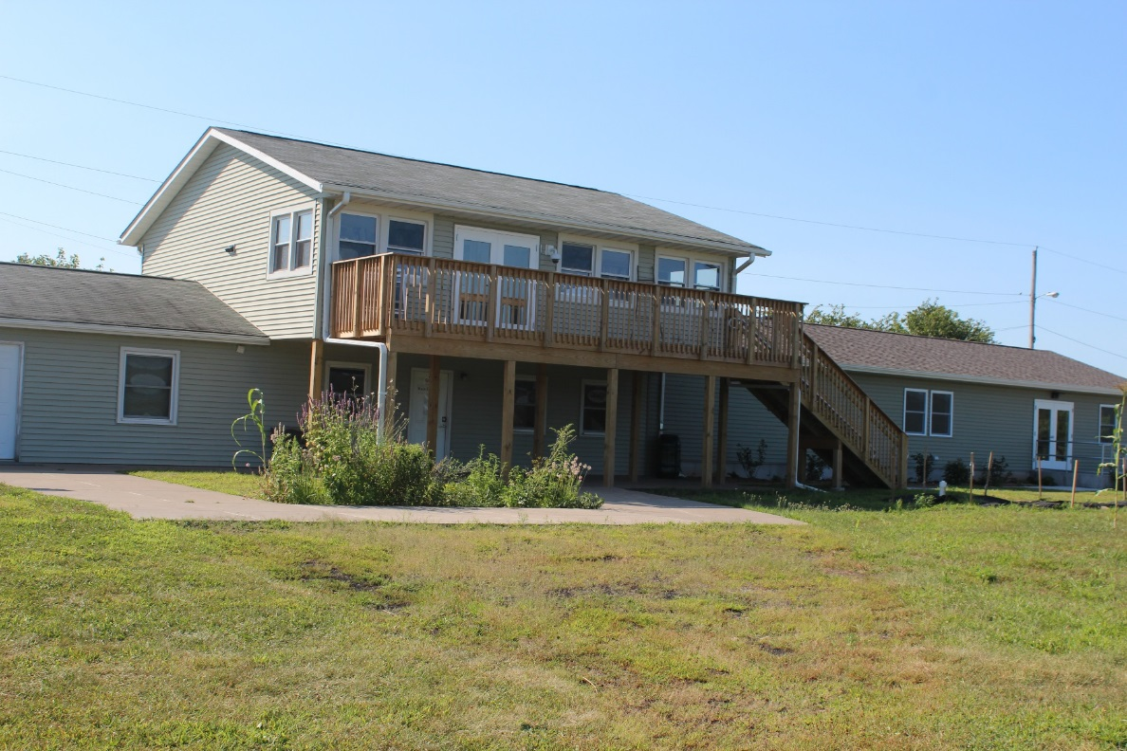
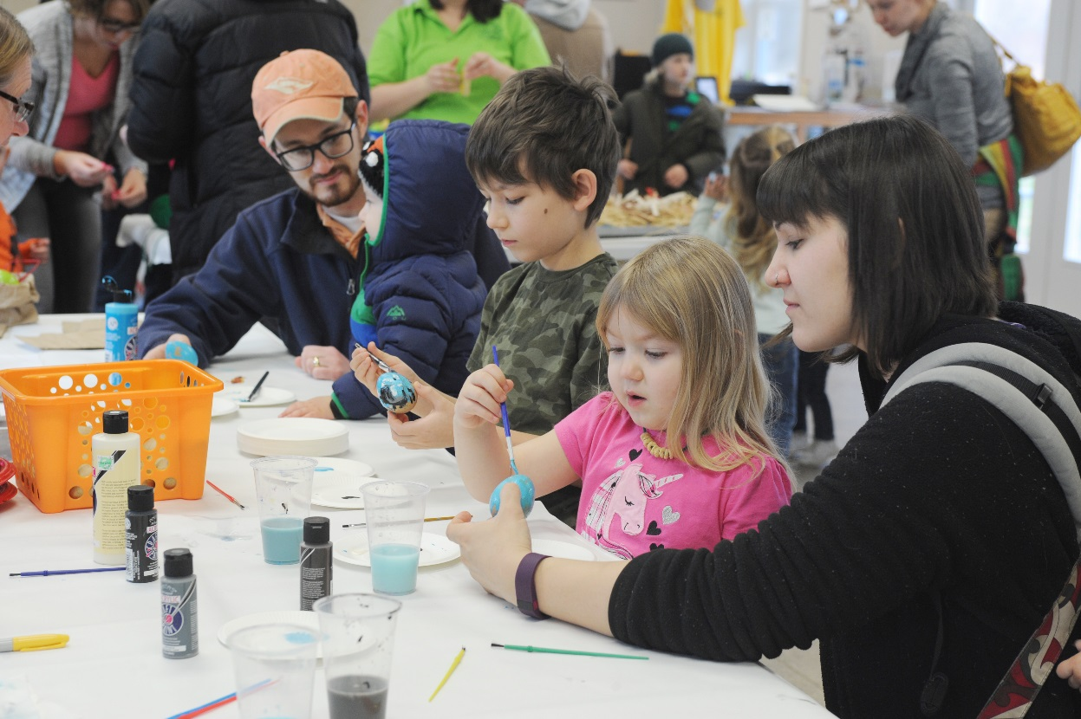
Education

Slide 33
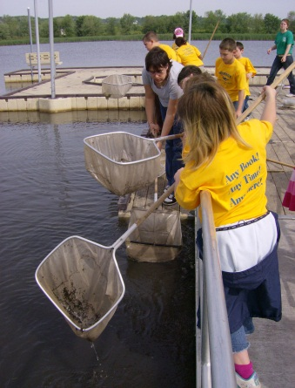
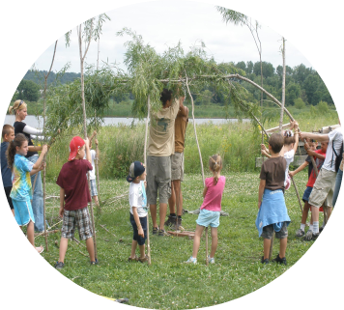

Slide 34
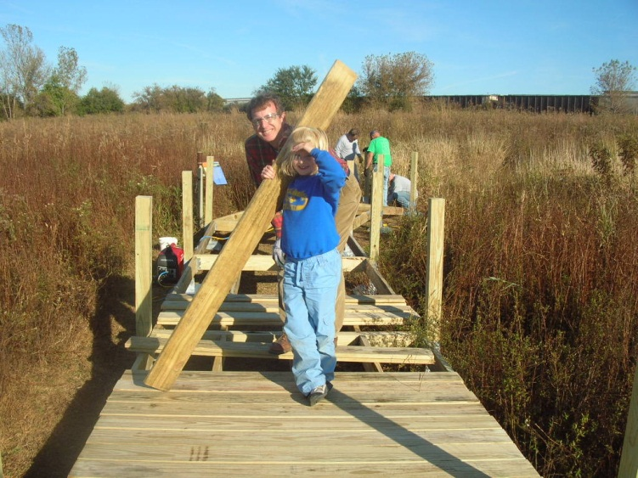
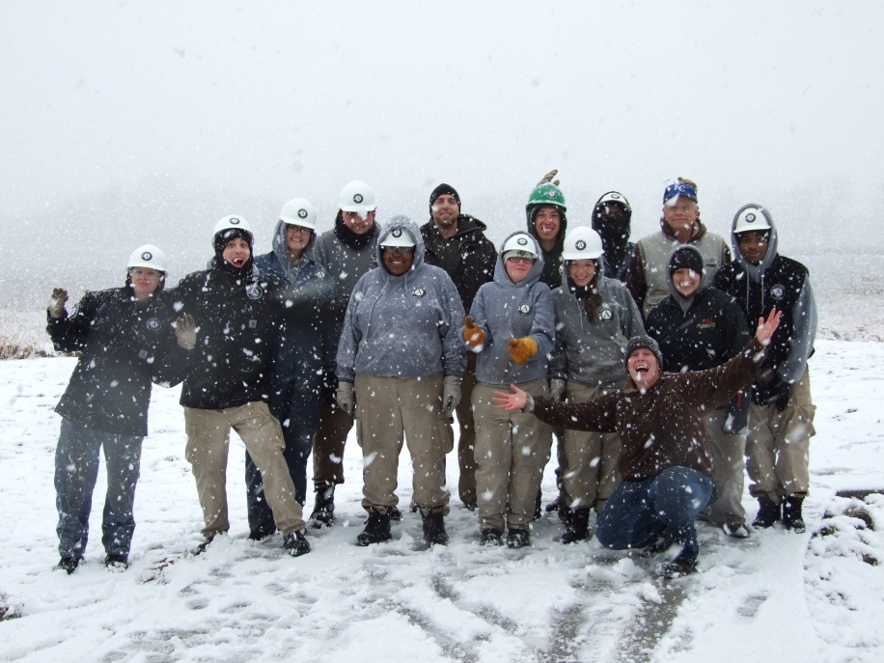
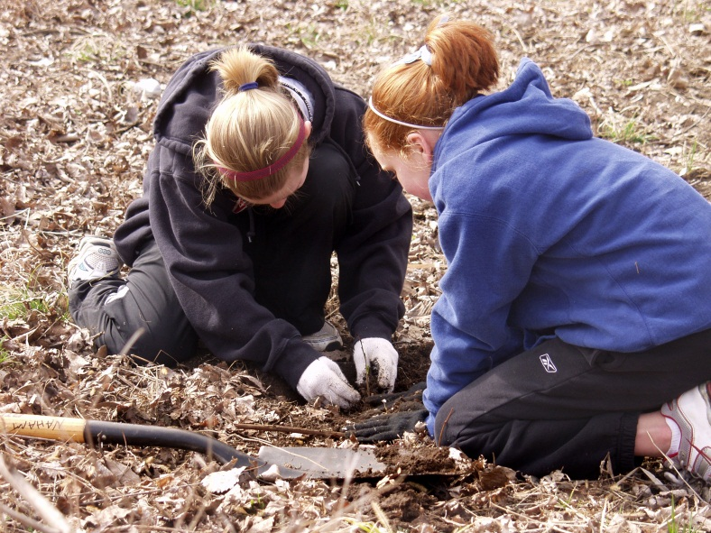
What IS Nahant?
Preservation and Restoration of natural resources

Slide 35
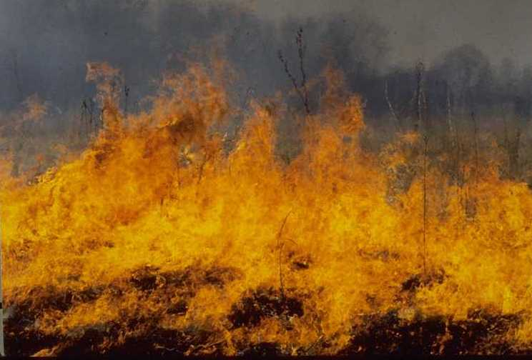
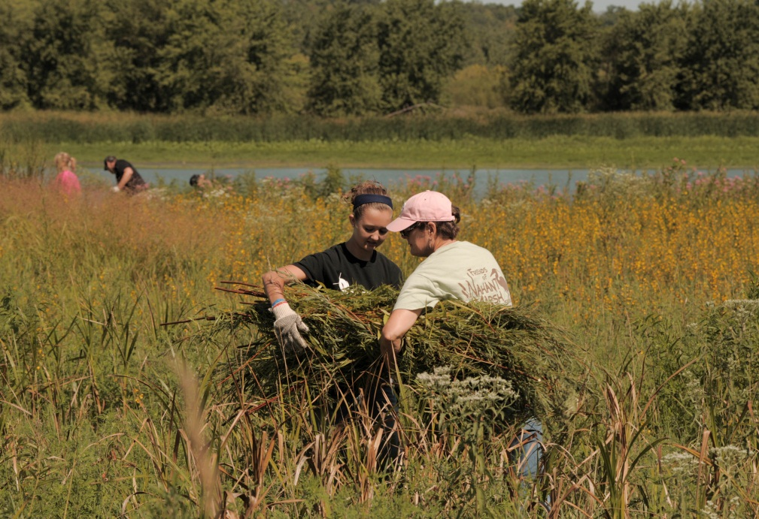
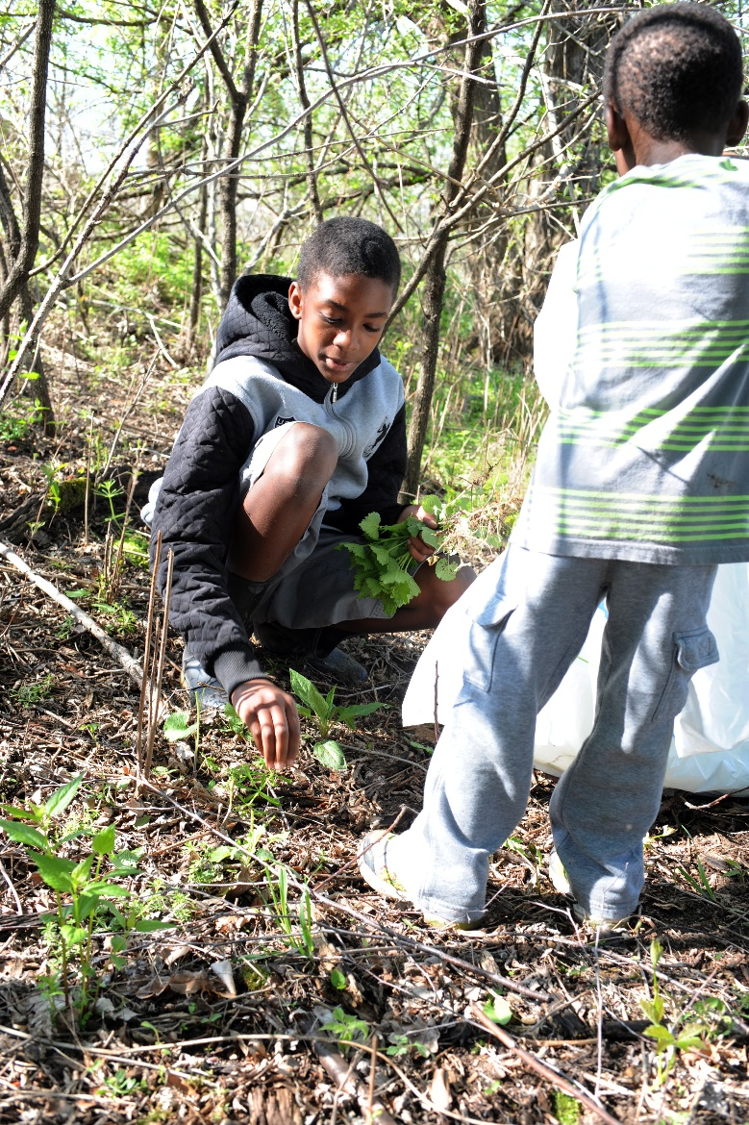
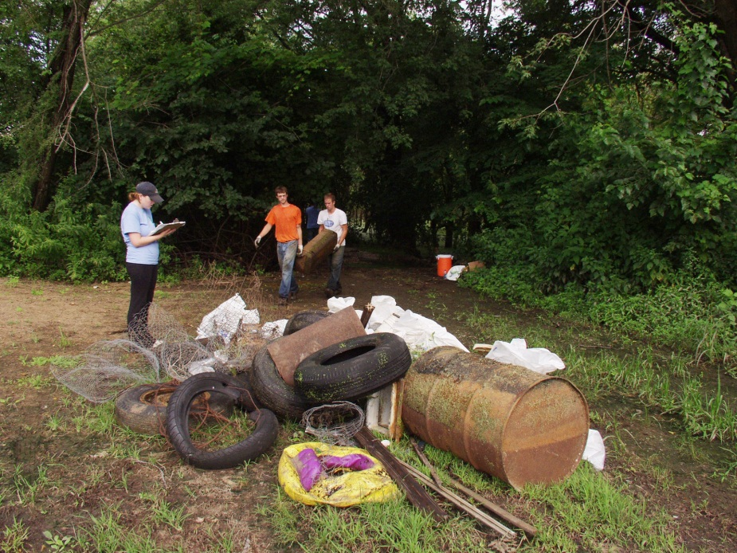


Slide 36





What IS Nahant?
Research

Slide 37

What IS Nahant?
Resilient, Yet Fragile
2000- 88 Acres protected
2017- 265 Acres protected

Slide 38

What IS Nahant?
2018- 304 Acres protected!!!

Slide 39


Slide 40


Slide 41
What IS Nahant?
Home to thousands
Documented at Nahant Marsh:
430 Plant Species
62 Fungus Species
181 Bird Species
41 Mammal Species
14 Reptile Species
7 Frog and Toad Species
Insects, Fish, etc.- No official Count yet

Slide 42








Slide 43







Slide 44










Slide 45


Slide 46


Slide 47


Slide 48


Slide 49



Slide 50


Slide 51


Slide 52


Slide 53

Future
Reconnect the Marsh!

Slide 54

Future
Watershed Approach

Slide 55

Future
Build Resiliency
Protect the remaining wetlands of Southwest Davenport
Create nature corridors to other preserves- Credit Island, Milan Bottoms, beyond

Slide 56

www.nahantmarsh.org
563-336-3370

